Slide 1

Coaching conversation in
Performance Management
Mohammad Mahdi Piroozan
Mohammad.Mahdi.Piroozan

Slide 2
Peter Drucker
if you can’t measure it, you can’t manage it

Slide 3
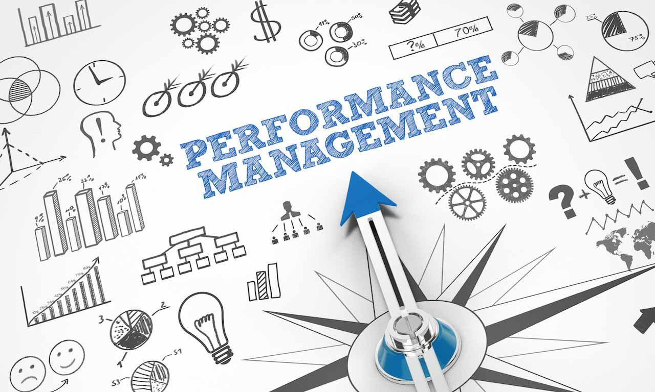
Performance management is a set of processes and systems aimed at developing an employee so they perform their job to the best of their ability.

Slide 4
Performance management is an ongoing process in which managers and employees regularly communicate to assess and review job responsibilities, expectations, performance, and development strategies. The goal is to empower employees to perform at their best, align their efforts with the organization’s strategic objectives, and create a positive and fulfilling work environment for everyone.

Slide 5
Job performance
Job performance is the degree to which an employee fulfills the tasks of their job description. People with good job performance fulfill all the requirements of their job, achieve the objectives of their jobs, and meet the criteria for performance. This is also referred to as in-role job performance.

Slide 6
Performance Management
performance management is a process that aims to align individual goals with group and organizational goals, it is a strategic and formal process. This means that key individual career decisions, like bonuses, promotions, and dismissals are all linked to this process.

Slide 7

Goal of Performance Management
Performance management is about measuring and improving the contribution of the employee to the organization. A famous quote attributed to Peter Drucker is “if you can’t measure it, you can’t improve it”. Or alternatively, “if you can’t measure it, you can’t manage it”.
Performance management is about measuring, managing, and improving the contribution of the individual to the organization.

Slide 8
Performance Appraisal
The performance appraisal is also referred to as the performance review, performance evaluation, and employee (performance) appraisal. A performance appraisal is a method to regularly evaluate an employee’s job performance and overall contribution to the company in order to improve that performance.
Performance appraisals help provide feedback, they offer a formal moment in time to evaluate job performance, and they help in distributing raises and bonuses among the employees.

Slide 9
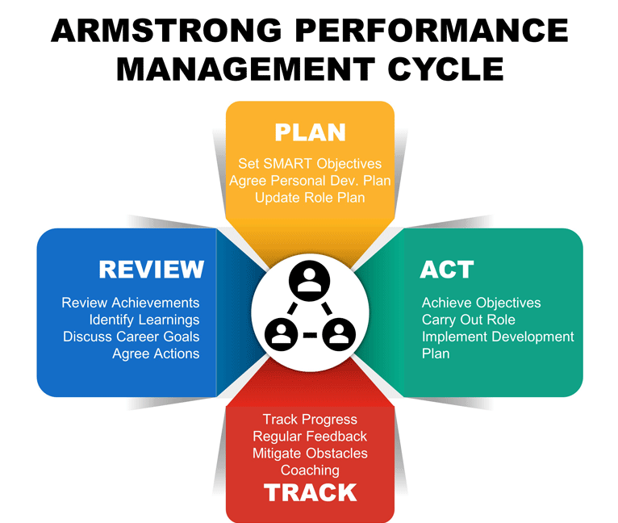

Slide 10
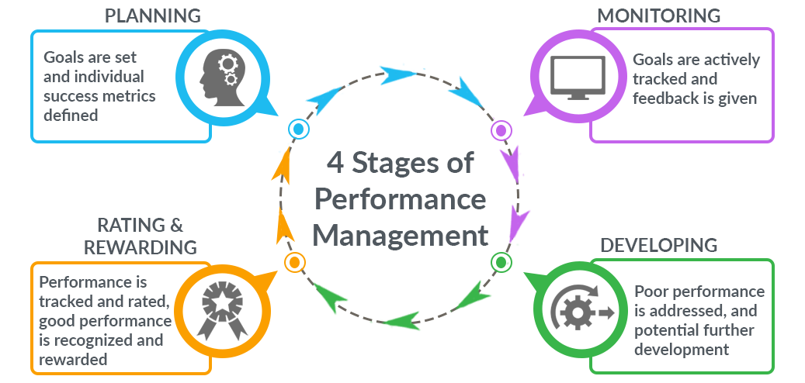
four-stage model
The model starts with planning, which involves setting goals and defining success metrics, usually at the beginning of the year. Once goals are set;
The second stage involves monitoring the progress of these goals. If there is potential for improvement, or performance is lacking;
Employee development takes place;
The employee is then rated and rewarded on their performance, and the cycle starts again

Slide 11
1:1 meeting
One-on-one meetings are a valuable tool for communication between employees and managers. Their purpose is to provide a scheduled time to discuss performance, address challenges, and explore professional development in a focused, supportive setting.
These meetings aren’t just about routine check-ins—they’re an opportunity to deepen working relationships, enhance engagement, and ensure team members feel recognized and supported in their roles.

Slide 12
Benefits of one-on-one meetings for employees
Feedback and development: One-on-one meetings provide a space for constructive feedback, helping employees understand performance strengths and areas for improvement in real time.
Goal alignment: Employees can discuss career goals, seek advice, and align their objectives with organizational needs, promoting growth.
Career growth opportunities: One-on-one meetings enable discussions on learning paths and growth opportunities—key motivators especially for more junior employees seeking development. Gallup’s recent report, How Millennials Want to Work and Live, indicates that learning and growth opportunities are extremely important for 59% of millennials when applying for a job. An impressive 87% of millennials consider ‘opportunities for professional or career growth and development’ as a significant factor in a job.
Engagement and retention: Having regular direct contact with a manager fosters a sense of value and recognition, which is directly linked to higher engagement and loyalty.

Slide 13
Benefits of one-on-one meetings for managers
Deeper insight: Managers can better understand each team member’s strengths, weaknesses, and morale to make more effective decisions.
Early intervention: Managers can address performance issues promptly, providing support or resources before problems escalate.
Agility and adaptability: Teams have a moment to reassess objectives and adjust if priorities change, keeping goals relevant and the team flexible.
Leadership development: Managers can strengthen their people management skills in communication, empathy, and problem-solving—essential qualities for effective leadership.

Slide 14
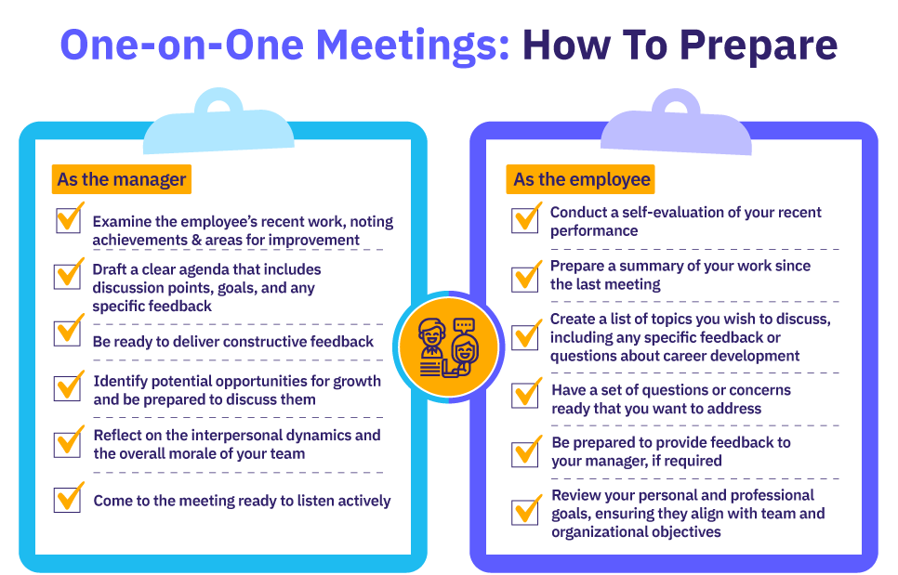

Slide 15
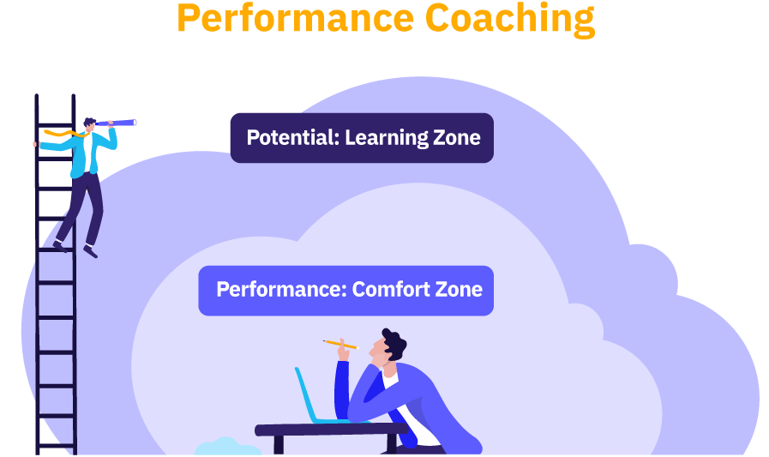

Slide 16
کوچینگ چیست؟
گفتگویی است بین کوچ و فرد مراجع.
مراجع، هدف مشخصی را انتخاب می‌کند و همراهی می‌شود تا گام به گام به هدفش برسد.
در این گفتگو، فرد به آگاهی‌های جدیدی می‌رسد و اقدام‌هایی برای اجرا در خارج از جلسه، انتخاب می‌کند.
در خارج از جلسه، فرد به اقدام‌های انتخاب شده عمل می‌کند و به توانایی‌های خودش پی می‌‌برد.
کوچینگ، همراهی فرد در توسعه، رشد و همچنین بهبود عملکرد اوست.
یادگیری
و
توانمندی
آگاهی
اقدام

Slide 17
مدیریت
منتورینگ
کوچینگ
تسهیلگری
برنامه‌ریزی، نظارت و هدایت افراد و تیم‌ها برای دستیابی به اهداف سازمانی
راهنمایی و حمایت افراد کم تجربه با انتقال دانش، تجربه و مهارت
همراهی افراد/تیم‌ها برای شناسایی و دستیابی به اهداف فردی و حرفه‌ای، توسعه مهارت‌ها و غلبه بر چالش‌ها
هدایت یک گروه یا تیم در یک مکالمه، جلسه یا کارگاه برای دستیابی به یک هدف مشخص، مانند رسیدن به ایده، تصمیم، راهکار یا اجماع
تمرکز
بی‌طرف نسبت به موضوع و افراد، کمک به استخراج اندوخته دانشی و تجربی از طریق ایجاد فضای گفتگو و تعامل و دستیابی به اجماع
دارای اختیار و مسئولیت برای تصمیم‌گیری، تخصیص منابع و پایش عملکرد
رابطه غیررسمی و طولانی، بر اساس اعتماد و احترام متقابل
حمایت و همراهی به سمت کشف و قبول تعهد برای توسعه
رویکرد
بلند‌مدت وابسته به نقش مدیریتی
چندین ماه تا چندین سال
کوتاه مدت یا
میان مدت
معمولاً کوتاه مدت و متمرکز بر وظیفه یا پروژه
زمان

Slide 18
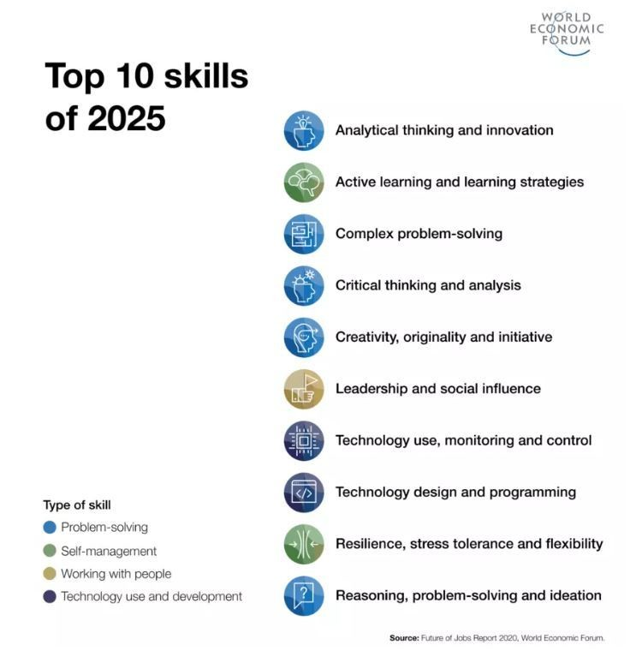
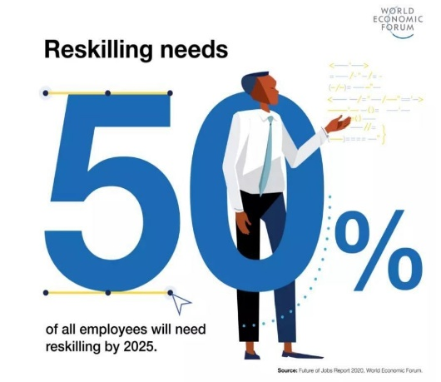
مدیر در نقش کوچ
کوچینگ برای مدیران
  هدف: کسب شایستگی‌های کوچینگ برای همراهی تیم، ایجاد تعهد، ارتقای نوآوری و ایجاد اعتماد و وفاداری و ...
  هدف: کارکردن مدیر بر روی نقاط قابل بهبود، دغدغه‌ها، تفکر و ...

Slide 19
Manager As Coach
Presence
حضور
Active
Listening
Trust & Intimacy
گوش کردن فعال
اعتماد و صمیمت
Powerful
Questioning
Feedback
بازخورد
سوال‌های قدرتمند
ایجاد ارتباط موثر

Slide 20
چارچوب گفتگوی کوچینگی مبتنی بر مدل GROW
WILL
OPTIONS
برنامه‌ریزی
تصمیم گیری برای برنامه عینی: کی، چی، چه وقتی چقدر
گزینه‌ها
بررسی گزینه‌های جدید برای رسیدن به هدف
REALITY
واقعیت
کاوش موقعیت کنونی
GOAL
  چه قدمی بر می دارید؟
هدف
شفاف سازی هدف و نتایج
چه کارهایی می‌توانید انجام دهید؟
الان شما کجا هستید؟
چه چیزی می خواهید؟

Slide 21
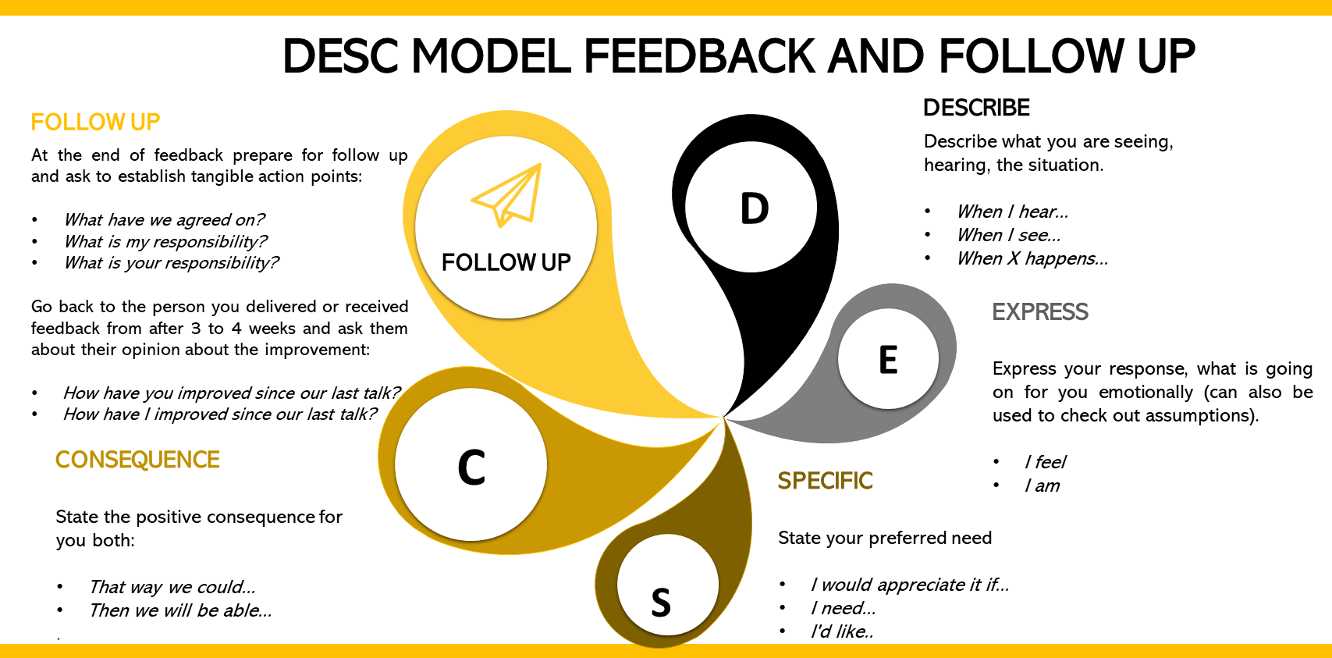

Slide 22
Thank You!
Mohammad.Mahdi.Piroozan

